Slide 1


Yashodhan Singh and Dimitri Ramoutar
Notes:
Yash - Brief intro about us and the game, from trinidad & tobago

Slide 2
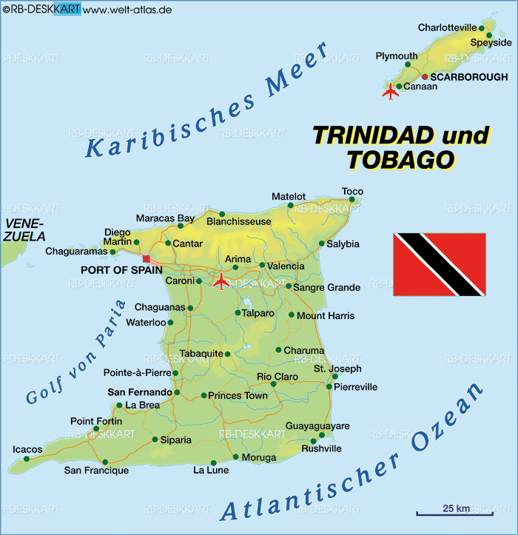
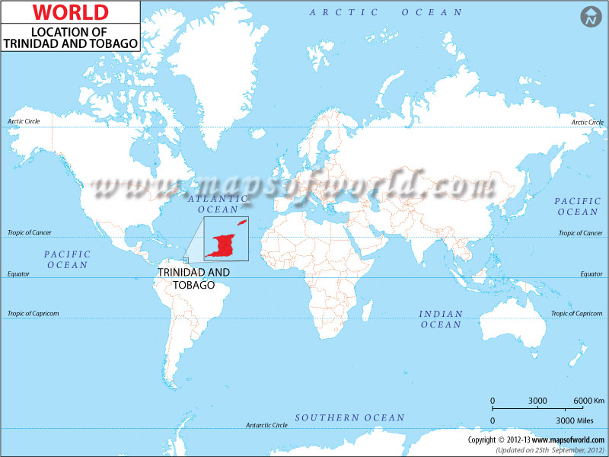
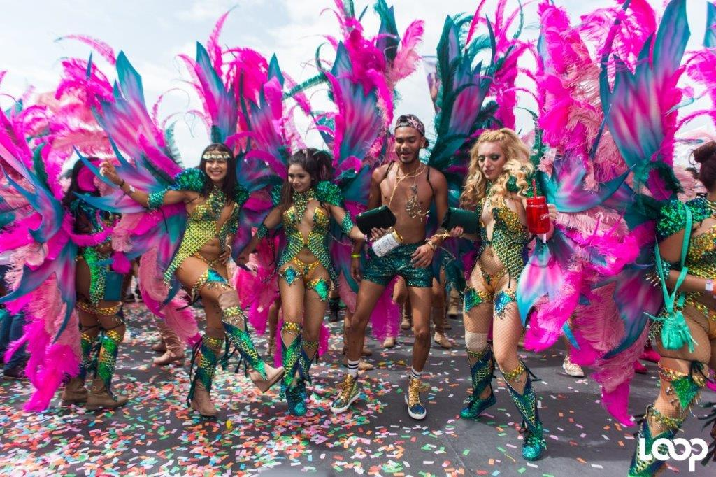



Trinidad and Tobago
Notes:
D: explaining trinidad & tobago
Y: Brief explanation why, segue in to rules

Slide 3
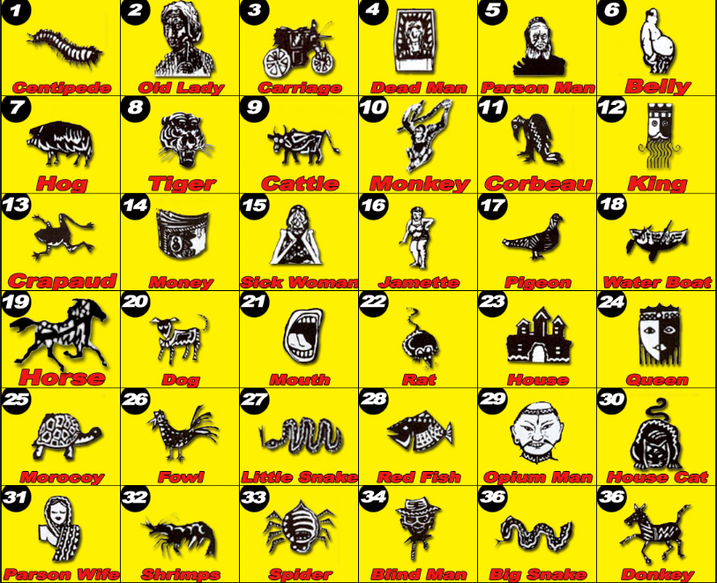
What is PlayWhe?
PlayWhe has its origins in China (Originally called Chinapoo) and brought to Trinidad during Indentureship in the 1800’s.
The game involves betting on a number between 1-36 called a mark, each of which has a name. (Similar to Roulette)
Players pick their numbers/marks based on their dreams, visions or superstitious belief.
They play at physical lottery booths and the results for draws are televised. There are four draws per day.
Notes:
D: Explaining the rules & how they are inconvenient (betting and knowing the associated words)

Slide 4
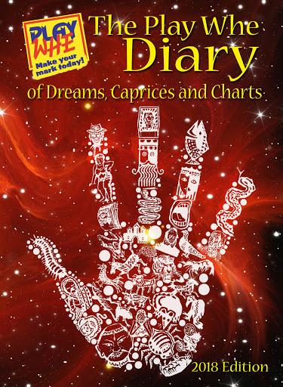
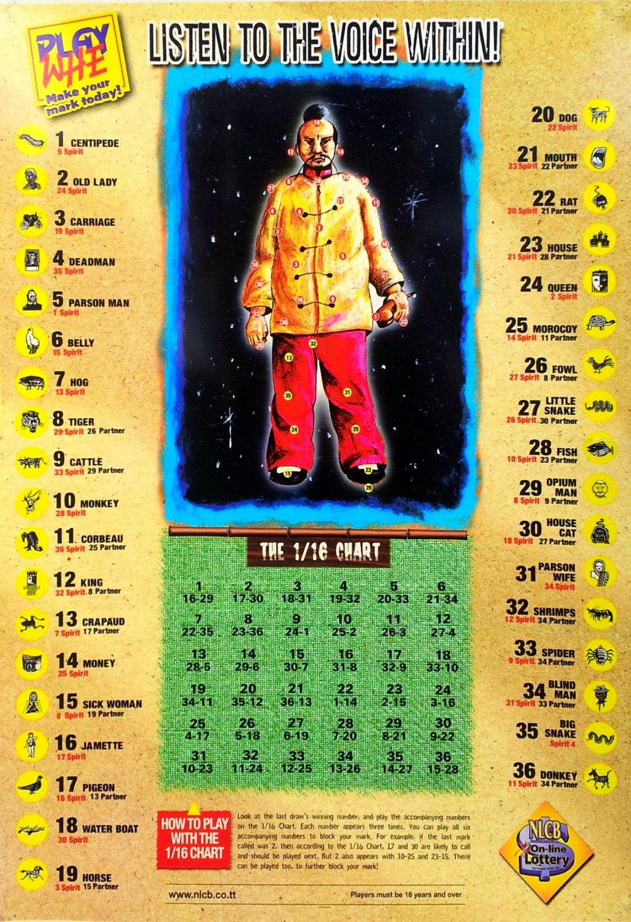
How players choose a “mark” (or number)
Numbers are chosen based on dreams/visions called “rakes”.
These associations between dreams and numbers have to be memorized or looked up in the official diary.
Newer players often have to ask older players to interpret their dreams since there are many associations.

Slide 5


Example Playthrough
Common dreams/visions for the “mark” 4-Dead Man:
Coffin, Hearse, Fire, Crying, Fresh Dead, Businessman, Blind, Rat, Murder, Debt.
Common dreams/visions for the “mark” 20-Dog:
Police, FBI, Thief, Merchant, Teeth, Hunger, Drought, Politician.
Notes:
D: example of playthrough, and how its about dreams (segue)

Slide 6
What we’re making
We’re targeting two inconveniences shown by this playthrough:
Choosing their mark
Using NLP to allow players to get marks recommended to them
They tell the app about their dreams, we algorithmically populate associated words & imagery in order to generate recommendations for them
Placing their bet
Using a database to store players’ account information
Allowing them to place bets in app, using virtual currency...
Notes:
Y: what we’re making, how it targets inconvenience of knowing words and betting, includes UI schematics

Slide 7

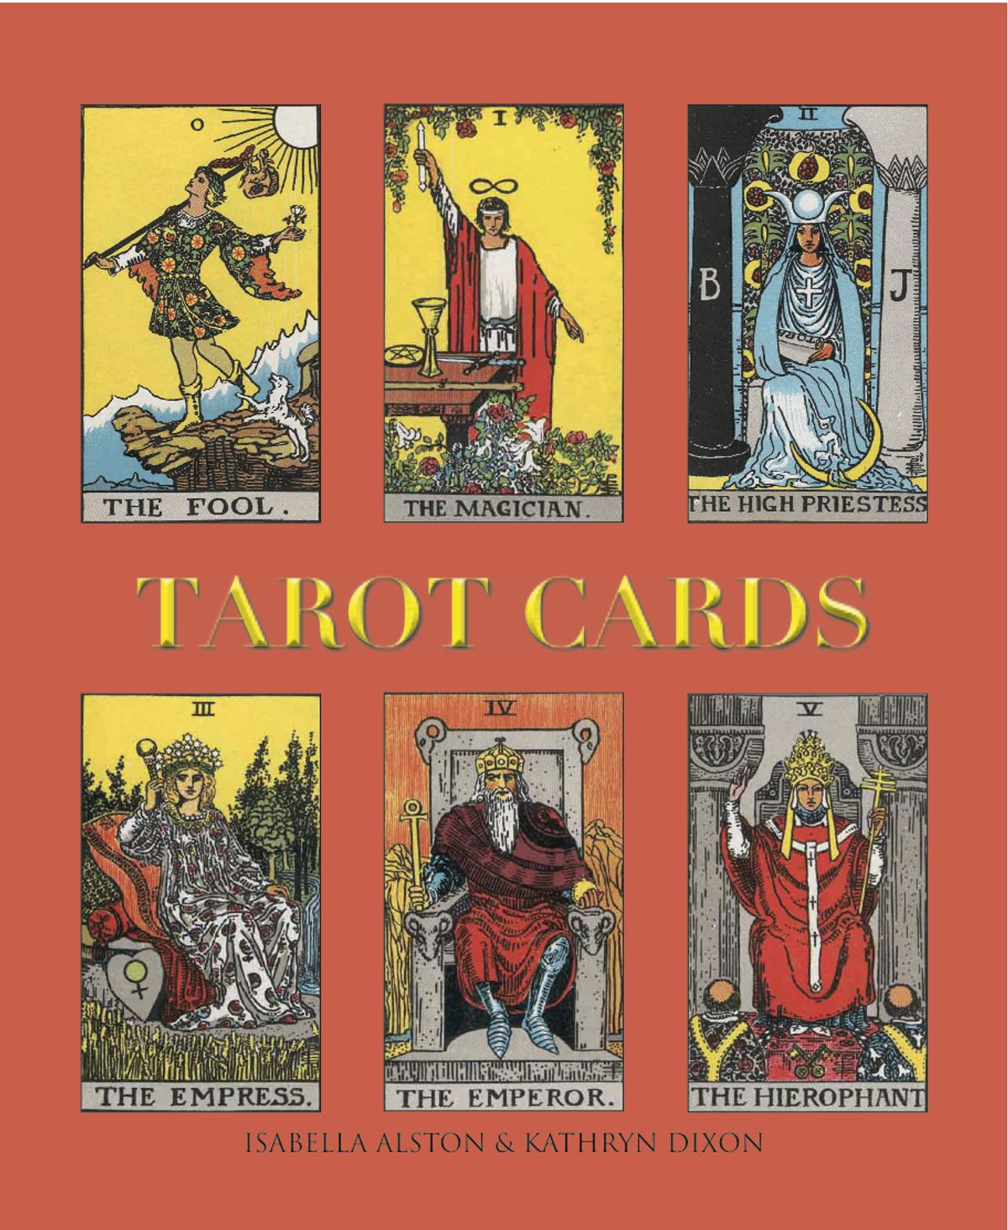

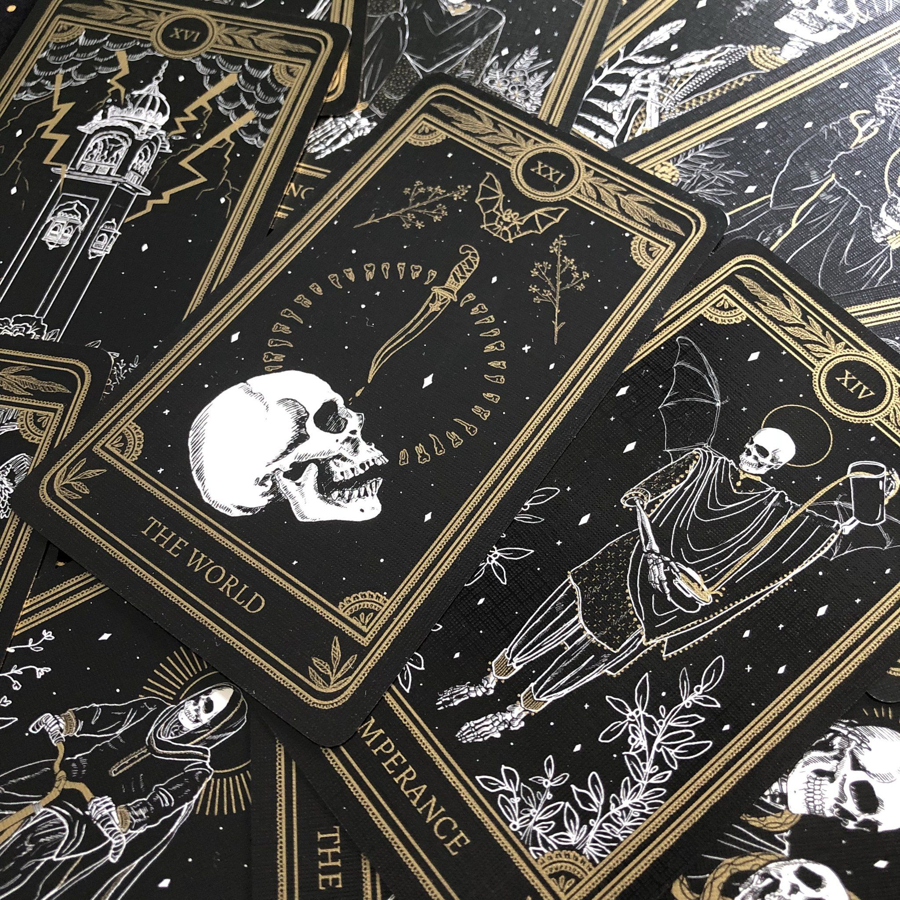
The spiritual aesthetic
Notes:
Y: dream aesthetic and how we will achieve that

Slide 8

The spiritual aesthetic (cont.)
Notes:
Y: dream aesthetic and how we will achieve that

Slide 9
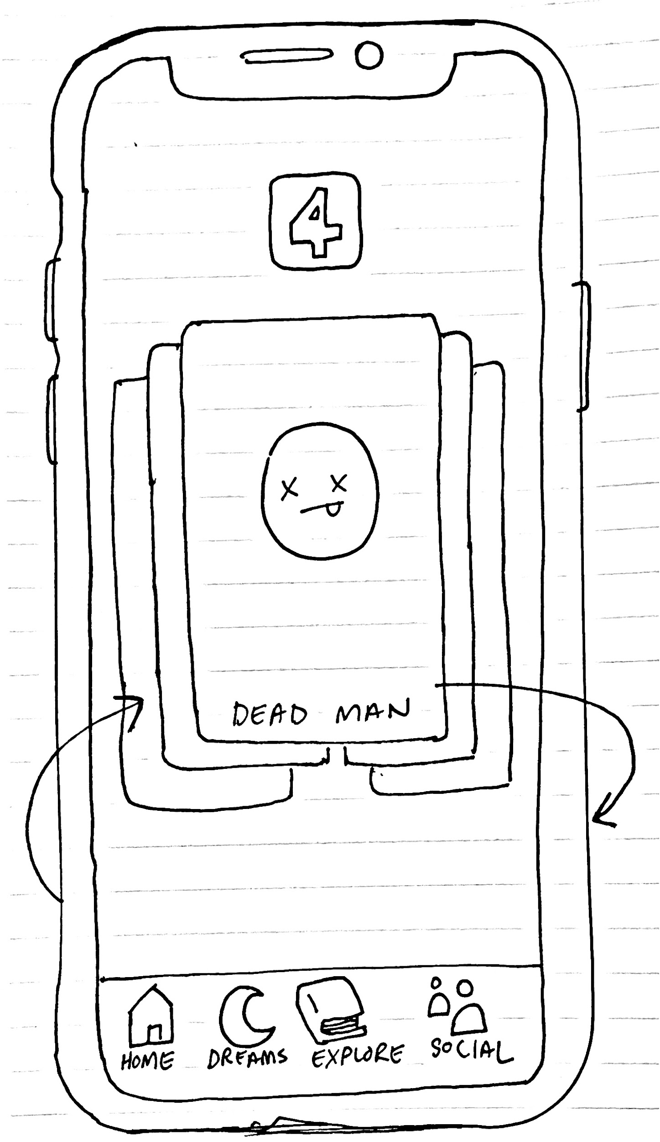
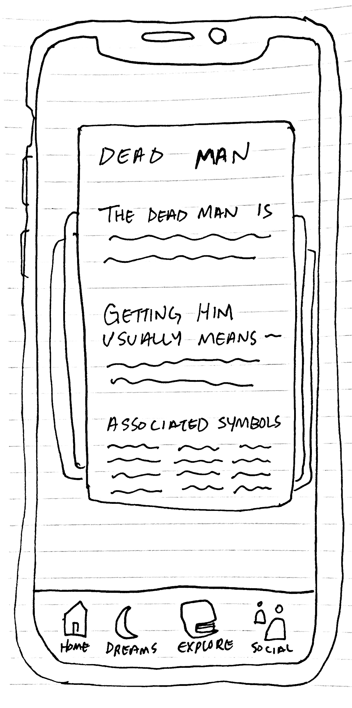
User Interface
Notes:
Y: what we’re making, how it targets inconvenience of knowing words and betting, includes UI schematics

Slide 10
Additional Features to develop
Technical Difficulties
Dream Journal
View Previous Draws
Share your dreams & mark choice with your friends
View your friends’ dreams or mark choice
Bet $$$
Notes:
Y: interesting features to implement throughout devleopment

Slide 11
Any questions or feedback?
Notes:
Questions?

